Slide 1

Singular Value Decomposition

Slide 2
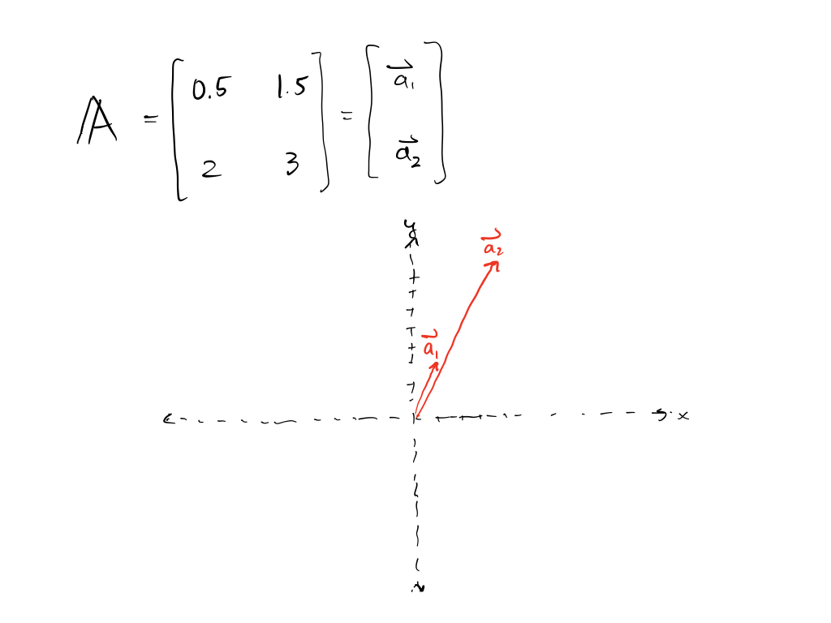

Slide 3
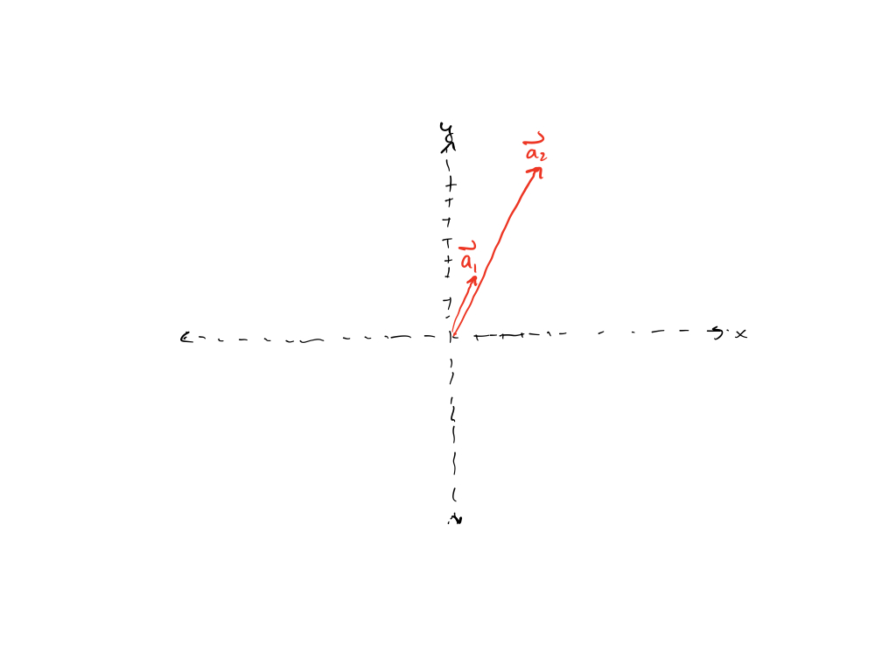

Slide 4
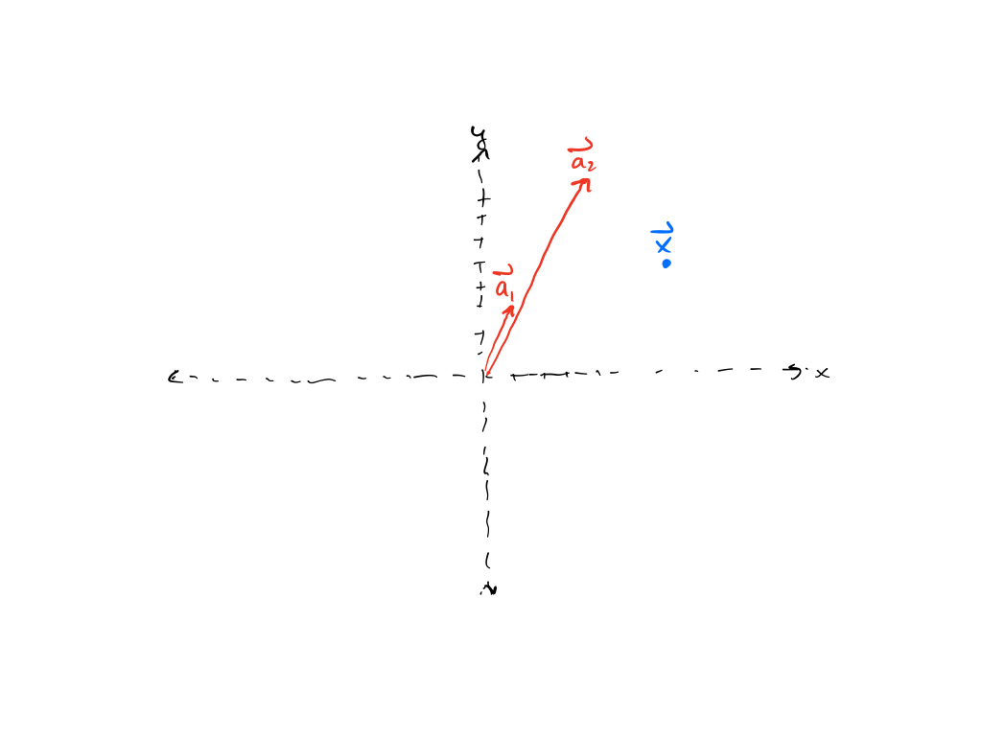

Slide 5
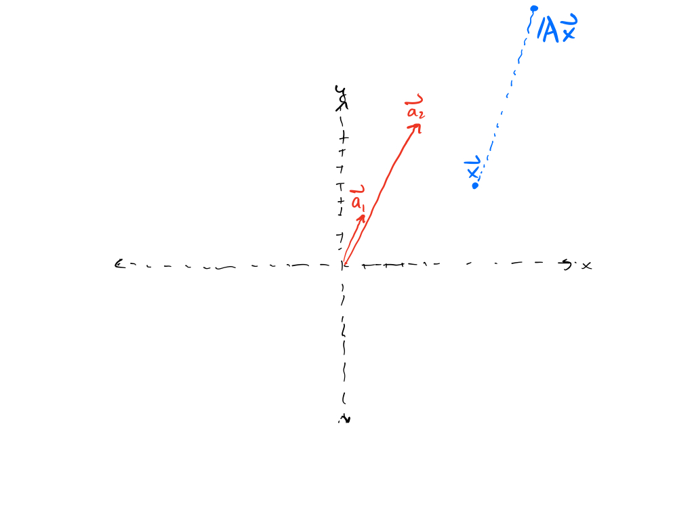

Slide 6
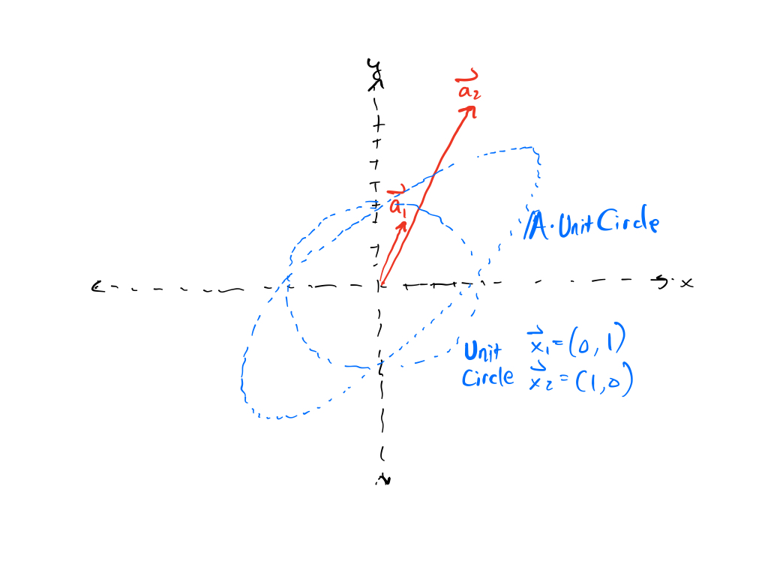

Slide 7
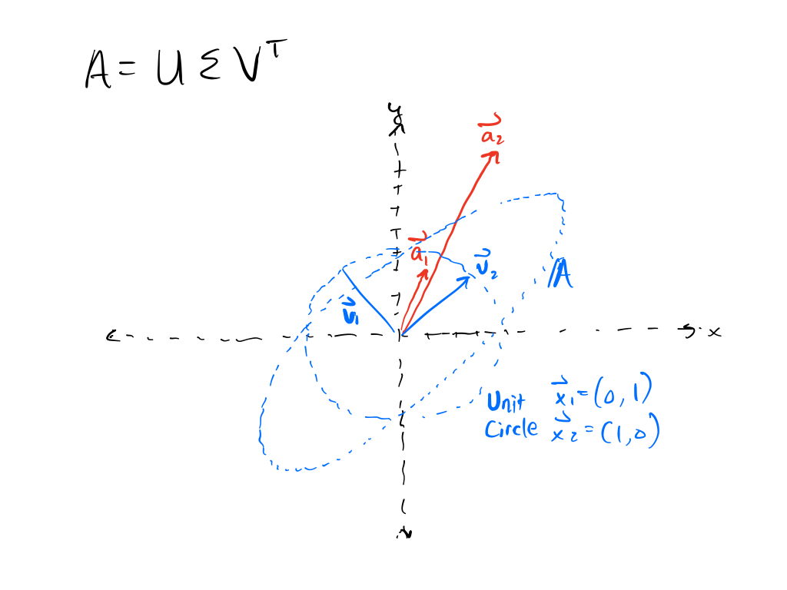

Slide 8
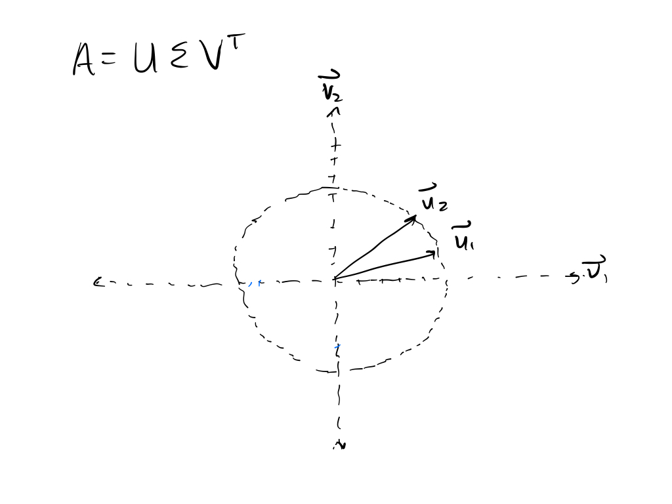

Slide 9
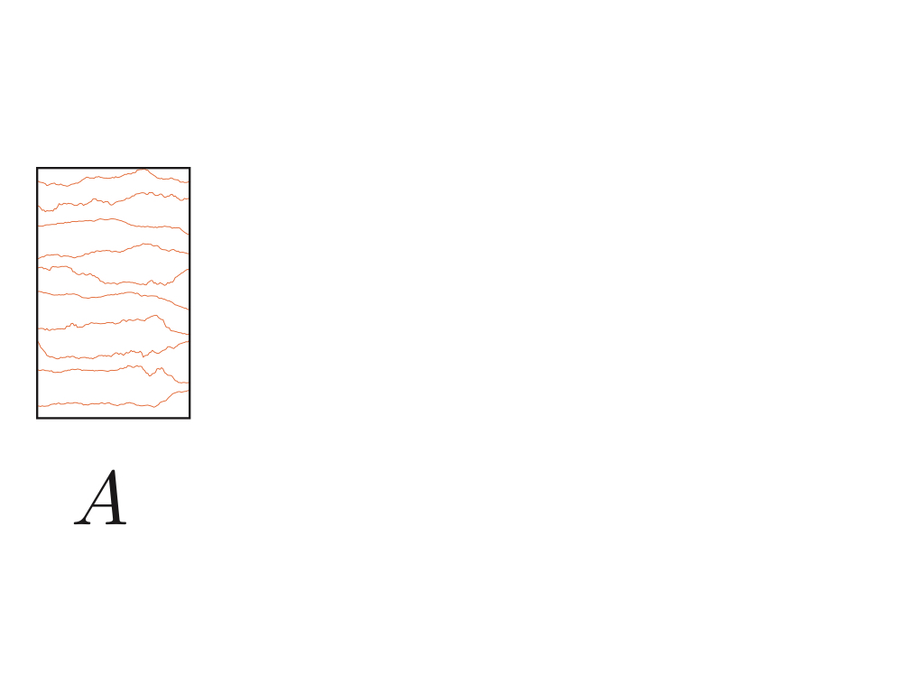

Slide 10
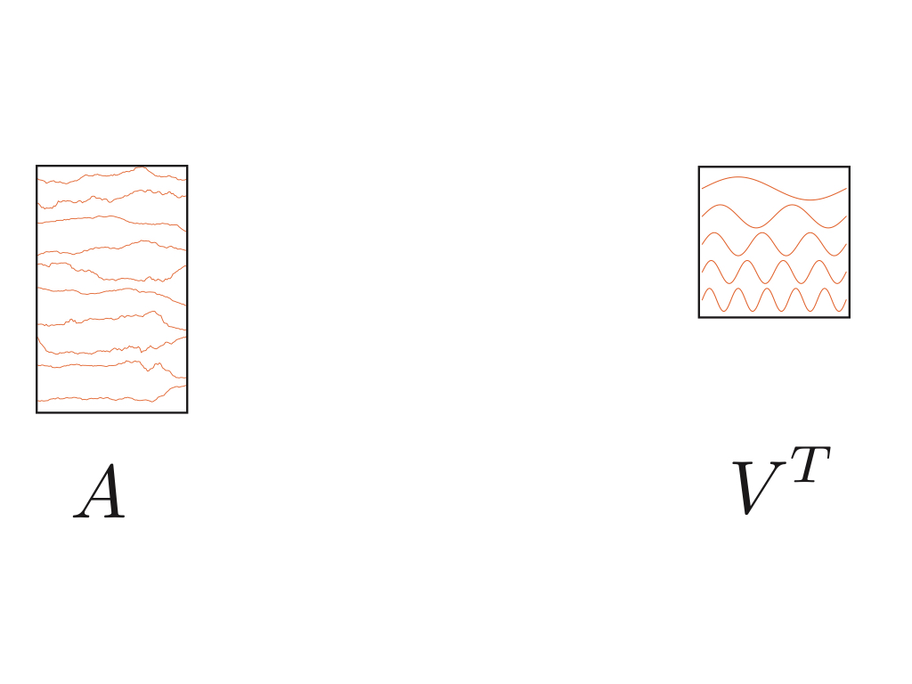

Slide 11
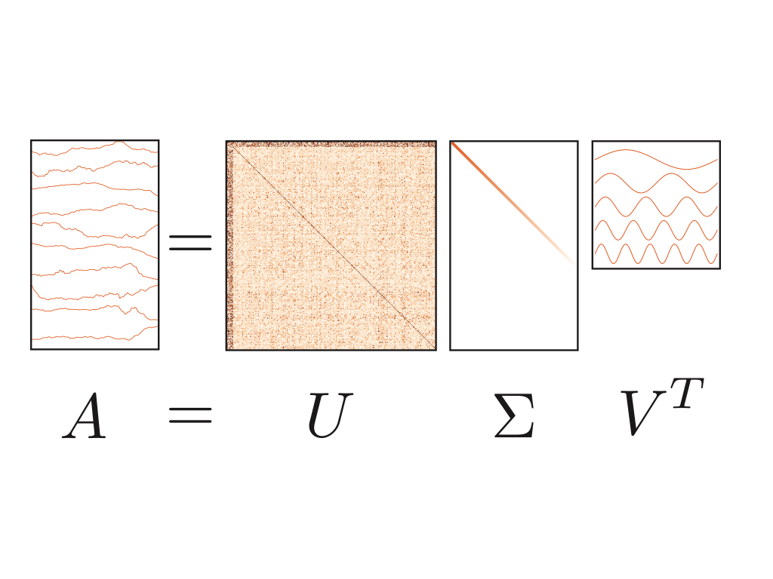

Slide 12
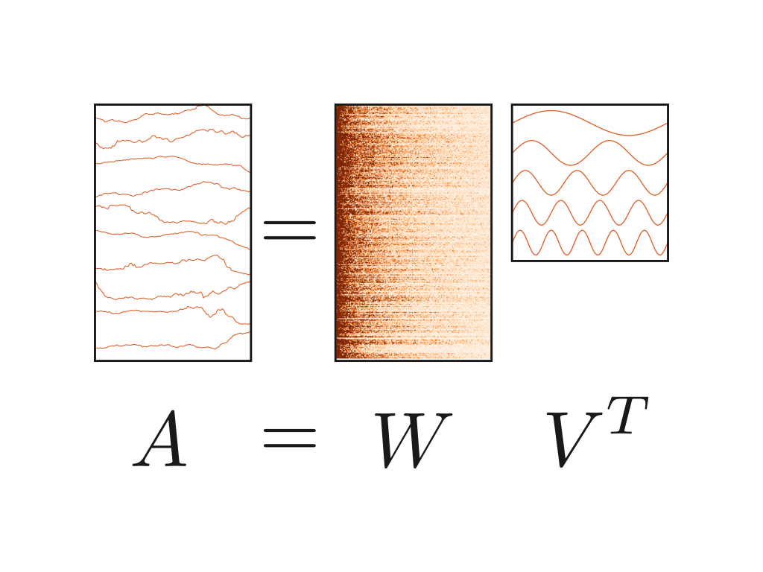

Slide 13
Singular Value Decomposition

Slide 14
SVD Compression
Notes:
unfortunate test image for all image compression

Slide 15
PCA
Notes:
Like SVD!
Generally operates on covariances, rather than raw data

Slide 16


